Slide 1
My Shape and Angles
Interactive Notebook
Name
Class
Term 3 Semester 2

Slide 2
Contents
Formula Page
Page
Date
Description
2
3

Slide 3
Tasks
24
7
30
Essential Question
Questions
Notes
Summary
8
9

Slide 4
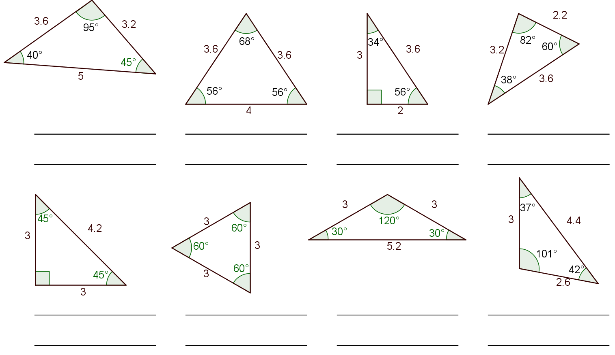
Task 1
Name the triangles according to the size of the angles
Name the triangles according to the length of the side

Slide 5
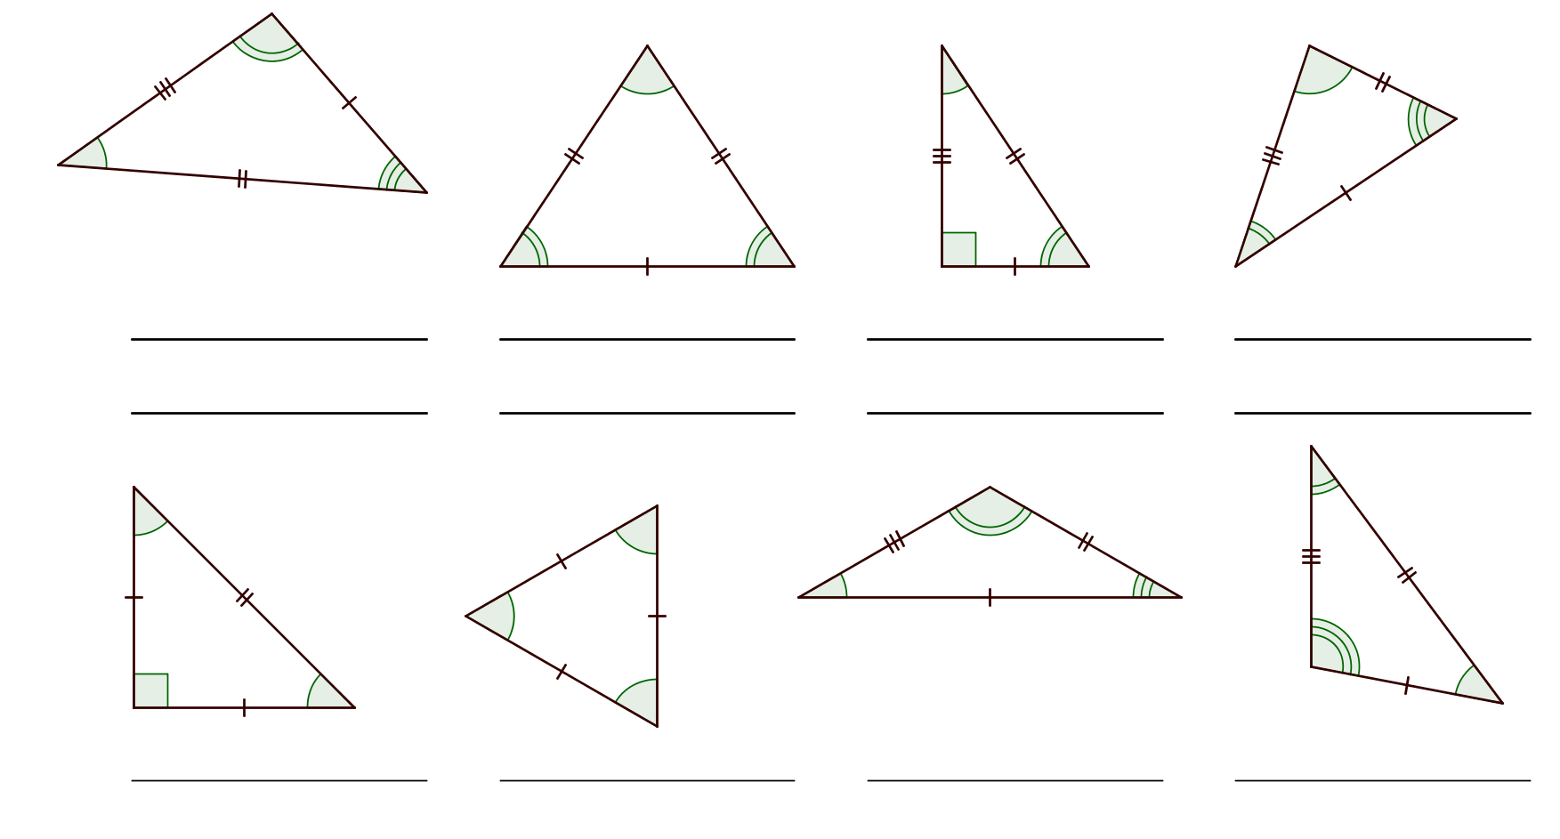

Slide 6
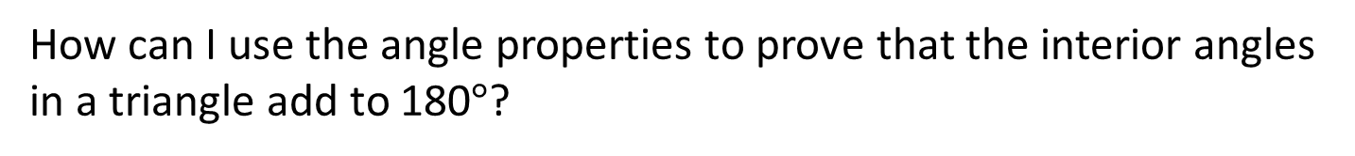
24
7
30
Date
Triangles
How can I use the angle properties to prove that the interior angles in a triangle add to 180$°$?
Triangles can be classified according to the size of the angles or the lengths of the sides.
9

Slide 7
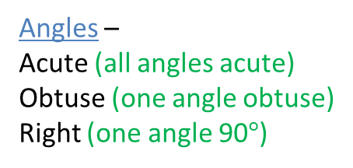
24
7
30
Date
Triangles
How can I use the angle properties to prove that the interior angles in a triangle add to 180$°$?
Triangles can be classified according to the size of the angles or the lengths of the sides.
Angles –
Acute (all angles acute)
Obtuse (one angle obtuse)
Right (one angle 90$°$)
9

Slide 8
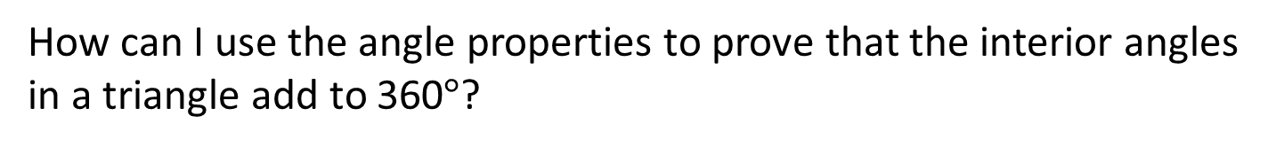
24
7
30
Date
Triangles
How can I use the angle properties to prove that the interior angles in a triangle add to 360$°$?
Triangles can be classified according to the size of the angles or the lengths of the sides.
Angles –
Acute (all angles acute)
Obtuse (one angle obtuse)
Right (one angle 90$°$)
Sides –
Equilateral (all sides equal)
Isosceles (two sides equal)
Scalene (all sides different)
9

Slide 9
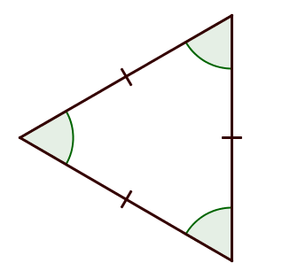
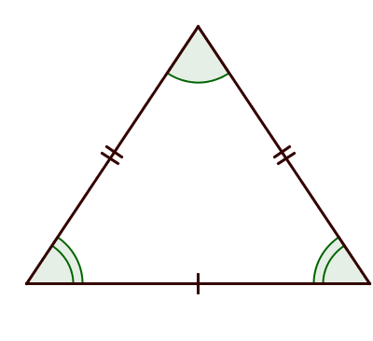
24
7
30
Date
Triangles
How can I use the angle properties to prove that the interior angles in a triangle add to 180$°$?
Triangles can be classified according to the size of the angles or the lengths of the sides.
Angles –
Acute (all angles acute)
Obtuse (one angle obtuse)
Right (one angle 90$°$)
Sides –
Equilateral (all sides equal)
Isosceles (two sides equal)
Scalene (all sides different)
9

Slide 10
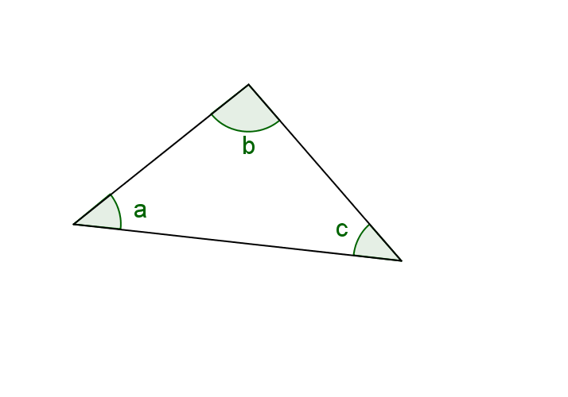
24
7
30
Date
Triangles
How can I use the angle properties to prove that the interior angles in a triangle add to 180$°$?
Sides –
Equilateral (all sides equal)
Isosceles (two sides equal)
Scalene (all sides different)
Angles in a triangle
9

Slide 11
Angles in a triangle demo

Slide 12

24
7
30
Date
Triangles
How can I use the angle properties to prove that the interior angles in a triangle add to 180$°$?
Sides –
Equilateral (all sides equal)
Isosceles (two sides equal)
Scalene (all sides different)
Angles in a triangle
Angles sum to 180$°$
9

Slide 13
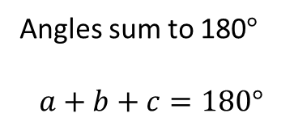
24
7
30
Date
Triangles
How can I use the angle properties to prove that the interior angles in a triangle add to 180$°$?
Sides –
Equilateral (all sides equal)
Isosceles (two sides equal)
Scalene (all sides different)
Angles in a triangle
Angles sum to 180$°$
$$a+b+c=180°$$
9

Slide 14
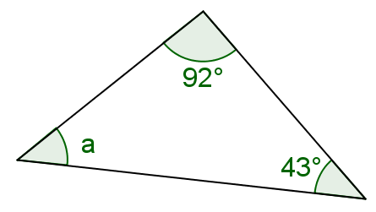
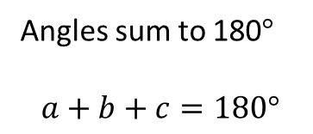
24
7
30
Date
Triangles
How can I use the angle properties to prove that the interior angles in a triangle add to 360$°$?
Angles in a triangle
Angles sum to 180$°$
$$a+b+c=180°$$
E.g. Find angle a
9

Slide 15
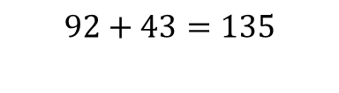
24
7
30
Date
Triangles
How can I use the angle properties to prove that the interior angles in a triangle add to 180$°$?
Angles in a triangle
Angles sum to 180$°$
$$a+b+c=180°$$
E.g. Find angle a
$$92+43=135$$
9

Slide 16
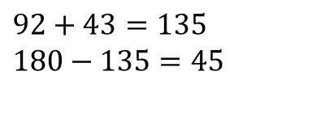
24
7
30
Date
Triangles
How can I use the angle properties to prove that the interior angles in a triangle add to 180$°$?
Angles in a triangle
Angles sum to 180$°$
$$a+b+c=180°$$
E.g. Find angle a
$$92+43=135$$
$$180−135=45$$
9

Slide 17
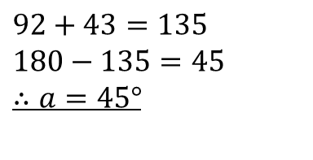
24
7
30
Date
Triangles
How can I use the angle properties to prove that the interior angles in a triangle add to 180$°$?
Angles in a triangle
Angles sum to 180$°$
$$a+b+c=180°$$
E.g. Find angle a
$$92+43=135$$
$$180−135=45$$
$$∴a=45°$$
9

Slide 18
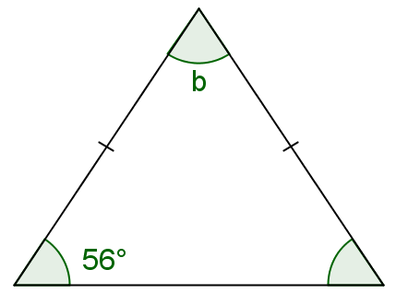
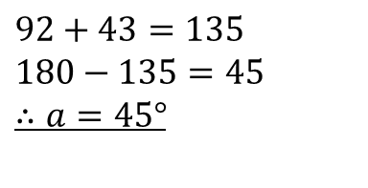
24
7
30
Date
Triangles
How can I use the angle properties to prove that the interior angles in a triangle add to 360$°$?
E.g. Find angle a
$$92+43=135$$
$$180−135=45$$
$$∴a=45°$$
Find angle b
9

Slide 19

24
7
30
Date
Triangles
How can I use the angle properties to prove that the interior angles in a triangle add to 180$°$?
E.g. Find angle a
$$92+43=135$$
$$180−135=45$$
$$∴a=45°$$
Find angle b
=56$°$
9

Slide 20


24
7
30
Date
Triangles
How can I use the angle properties to prove that the interior angles in a triangle add to 180$°$?
E.g. Find angle a
$$92+43=135$$
$$180−135=45$$
$$∴a=45°$$
Find angle b
$$56+56=112$$
56$°$
9

Slide 21
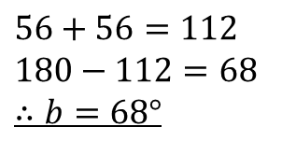
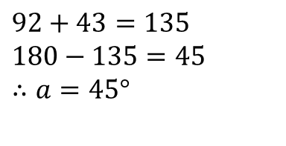
24
7
30
Date
Triangles
How can I use the angle properties to prove that the interior angles in a triangle add to 180$°$?
E.g. Find angle a
$$92+43=135$$
$$180−135=45$$
$$∴a=45°$$
Find angle b
$$56+56=112$$
$$180−112=68$$
$$∴b=68°$$
56$°$
9

Slide 22
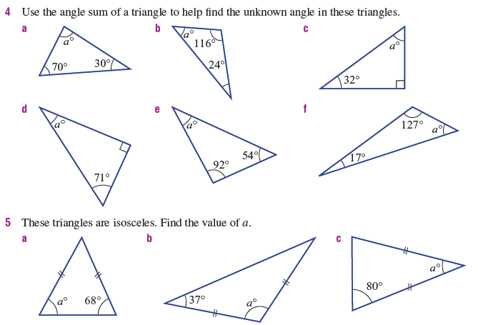
Page 65 - Textbook

Slide 23
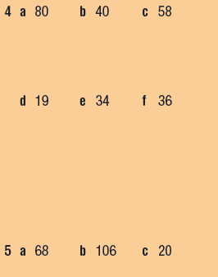
Answers

Slide 24
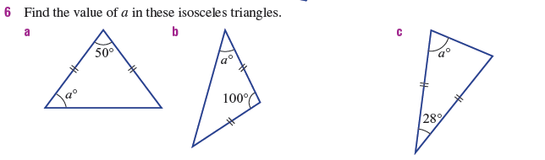

Slide 25
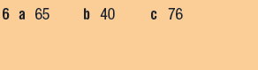
Answers

Slide 26
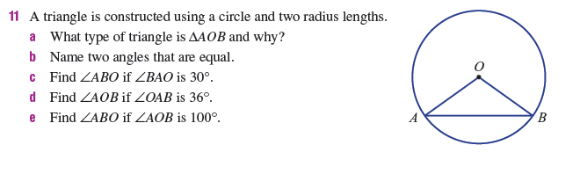

Slide 27
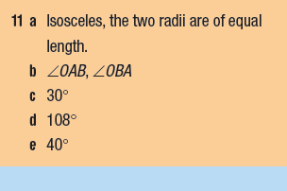
Answers

Slide 28
Fill in the questions

Slide 29
24
7
30
Date
Triangles
How can I use the angle properties to prove that the interior angles in a triangle add to 180$°$?
How are different triangles classified?
Triangles can be classified according to the size of the angles or the lengths of the sides.
Angles –
Acute (all angles acute)
Obtuse (one angle obtuse)
Right (one angle 90$°$)
Sides –
Equilateral (all sides equal)
Isosceles (two sides equal)
Scalene (all sides different)
9

Slide 30
24
7
30
Date
Triangles
How can I use the angle properties to prove that the interior angles in a triangle add to 180$°$?
How do I find the angles in a triangle?
Angles in a triangle
Angles sum to 180$°$
$$a+b+c=180°$$
Examples
E.g. Find angle a
$$92+43=135$$
$$180−135=45$$
$$∴a=45°$$
9

Slide 31
Notes Review
24, 7 ,30
Date
Title
Essential question
Notes complete
Notes complete with colour and diagrams
Questions completed
Contents page filed in
Formula page filled in

Slide 32
Homework
Review your notes and write a summary answering the essential question.

